Slide 1
Chapter 4
Landmark Summaries: Interpreting Typical Values and Percentiles
Elsevier/Academic Press
© Andrew F. Siegel, 2016

Slide 2
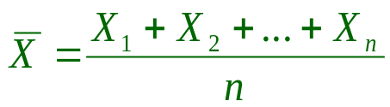
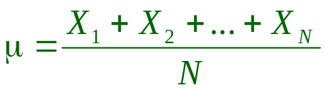
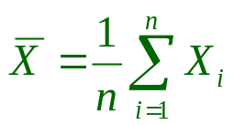
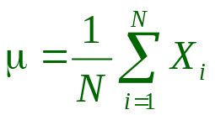
Average or Mean
Add the data, divide by n or N (the number of elementary units)
Divides total equally. The only such summary
A representative, central number (if data set is approximately normal)
Summation notation
  Σ is capital Greek sigma
“X-bar”
Sample average
“mu”
Population average
Elsevier/Academic Press
© Andrew F. Siegel, 2016

Slide 3
Example: Number of Defects
Fig 4.1.1
Defects measured for each of 10 production lots
  4, 1, 3, 7, 3, 0, 7, 14, 5, 9
2
Frequency (lots)
0
0
5
10
15
20
Defects per lot
Average is 5.1
defects per lot
Elsevier/Academic Press
© Andrew F. Siegel, 2016

Slide 4
Median
Also summarizes the data
The middle one
  Put data in order
  Pick middle one (or average middle two if n is even)
  Median (9, 4, 5) = Median(4, 5, 9) = 5
  Median (9, 4, 5, 7) = Median (4, 5, 7, 9) = = 6
Rank of the median is (1+n)/2
  If n=3, rank is (1+3)/2 = 2
  If n=4, rank is (1+4)/2 = 2.5 (so average 2nd and 3rd)
  If n=262, rank is (1+262)/2 = 131.5
5+7
2
Elsevier/Academic Press
© Andrew F. Siegel, 2016

Slide 5
Median (continued)
A representative, central number
  If data set has a center
Less sensitive to outliers than the average
For skewed data, represents the “typical case” better than the average does
  e.g., incomes
    Average income for a country equally divides the total, which may include some very high incomes
    Median income chooses the middle person (half earn less, half earn more), giving less influence to high incomes (if any)
Elsevier/Academic Press
© Andrew F. Siegel, 2016

Slide 6
Example: Spending
Customers plan to spend ($thousands)
  3.8, 1.4, 0.3, 0.6, 2.8, 5.5, 0.9, 1.1
Rank ordered from smallest to largest
  0.3, 0.6, 0.9, 1.1, 1.4, 2.8, 3.8, 5.5
  1 2 3 4 5 6 7 8
Median is (1.1+1.4)/2 = 1.25
  Smaller than the average, 2.05
    Due to slight skewness?
Data
Ranks
Rank of median
= (1+8)/2 = 4.5
9
6 4
3 1 8 8 5
0 1 2 3 4 5
Median
Average
Elsevier/Academic Press
© Andrew F. Siegel, 2016

Slide 7
Example: The Crash of 1987
Fig 4.1.2
Dow-Jones Industrials, stock-price changes as each stock began trading that fateful morning
Fairly normal
Mean and median are similar
5
Frequency
0
-20%
-10%
0%
Median = -8.6%
Percent change at opening
Average = -8.2%
Elsevier/Academic Press
© Andrew F. Siegel, 2016

Slide 8
Example: Incomes
Fig 4.1.3
Personal income of 100 people
Average is higher than median due to skewness
50
40
30
Frequency
20
10
0
$0
$100,000
$200,000
Income
Average = $38,710
Median = $27,216
Elsevier/Academic Press
© Andrew F. Siegel, 2016

Slide 9
Mode
Also summarizes the data
Most common data value
  Middle of tallest histogram bar
Problems:
  Depends on how you draw histogram (bin width)
  Might be more than one mode (two tallest bars)
Good if most data values are “correct”
Good for nominal data (e.g., elections)
Mode
Mode
Elsevier/Academic Press
© Andrew F. Siegel, 2016

Slide 10
Normal Distribution
Average, median, and mode are identical
  If the data come from a normal distribution
Average, median, and mode
are identical
in the case of a normal distribution
Elsevier/Academic Press
© Andrew F. Siegel, 2016

Slide 11
Skewed Distribution
Average, median, and mode are different
  The few large (or small) values influence the mean more than the median
  The highest point is not in the center
Average
Median
Mode
Elsevier/Academic Press
© Andrew F. Siegel, 2016

Slide 12
Which summary to use?
Average
  Best for normal data
  Preserves totals
Median
  Good for skewed data or data with outliers, provided you do not need to preserve or estimate total amounts
Mode
  Best for categories (nominal data).
  The mode is the only summary computable for nominal data!
Elsevier/Academic Press
© Andrew F. Siegel, 2016

Slide 13
Which Summary? (continued)
Average requires quantitative data (numbers)
Median works with quantitative or ordinal
Mode works with quantitative, ordinal, or nominal
Quantitative Ordinal Nominal
Average Yes - -
Median Yes Yes -
Mode Yes Yes Yes
Elsevier/Academic Press
© Andrew F. Siegel, 2016

Slide 14
Weighted Average
Ordinary average gives same weight to all elementary units
Weighted average allows different weights
Weights must add up to 1
  If not, then divide each by their total
=
1
+
1
+
+
1
X
X
X
...
X
n
1
n
2
n
n
X
=
w
X
+
w
X
+
...
+
w
X
1
1
2
2
n
n
w
+
w
+
...
+
w
=
1
1
2
n
Elsevier/Academic Press
© Andrew F. Siegel, 2016

Slide 15
Weighted Average (continued)
Average is per elementary unit
  The average of your course grades is your “average per course”
Weighted average is per unit of weight
  Your GPA (grade point average) is a weighted average, using credit hours to define the weights. The weighted average is your “average per credit hour”
Elsevier/Academic Press
© Andrew F. Siegel, 2016

Slide 16
Example: Portfolio Rate of Return
Portfolio expected return (an interest rate, indicating performance) is the weighted average of the expected rates of return of assets in the portfolio, weighted by dollars invested
Portfolio contains three stocks. One ($1,000 invested) is expected to return 20%. Another ($1,800 invested) expects 15%. Third is $2,200 and 30%.
Total invested is 1,000 + 1,800 + 2,200 = $5,000
Elsevier/Academic Press
© Andrew F. Siegel, 2016

Slide 17
Example (continued)
Weights are
  w₁ = $1,000/$5,000 = 0.20
  w₂ = $1,800/$5,000 = 0.36
  w₃ = $2,200/$5,000 = 0.44
Weighted average is
  0.20×(20%) + 0.36×(15%) + 0.44×(30%) = 22.6%
  The expected return for the portfolio.
  Each stock is represented in proportion to $ invested
Elsevier/Academic Press
© Andrew F. Siegel, 2016

Slide 18
Percentiles
Landmark summaries in the same measurement units as the data
  e.g., dollars, people, miles per gallon, …
Some familiar percentiles
  Smallest data value is 0th percentile
  Median is 50th percentile
  Largest data value is 100th percentile
  90th percentile is larger than 90% of elementary units
Finding percentiles
  Difficult to see from histogram
  Easy using CDF (Cumulative Distribution Function)
Elsevier/Academic Press
© Andrew F. Siegel, 2016

Slide 19
Cumulative Distribution Function
Data axis horizontally (as in histogram)
Cumulative percent vertically
Equal vertical jump at each data value
  0.3, 0.6, 0.9, 1.1, 1.4, 2.8, 3.8, 5.5
80%
100%
50%
Cumulative
Percent
0%
$0
$2
$4
$6
Spending
80th percentile
is $3.80
Elsevier/Academic Press
© Andrew F. Siegel, 2016

Slide 20
Five-Number Summary
Selected landmarks to represent entire data set
  Median = 50th percentile
  Quartiles
    LQ = Lower Quartile = 25th percentile
      Rank =
    UQ = Upper Quartile = 75th percentile
      Rank is n+1–[rank of lower quartile]
  Extremes
    Smallest = 0th percentile
    Largest = 100th percentile
Discard decimal,
if any.
int(10.5)=10
int(35)=35
⎡
1
+
n
⎤
1
+
int
⎢
⎥
⎣
2
⎦
Rank of median
2
Elsevier/Academic Press
© Andrew F. Siegel, 2016

Slide 21
Five-Number Summary (continued)
Provides information about
  Central summary
    Median
  Range of the data
    Largest – smallest
  “Middle half” of the data
    From LQ to UQ
  Skewness
    If median is not approximately half way between quartiles
Elsevier/Academic Press
© Andrew F. Siegel, 2016

Slide 22
Box Plot
Displays five-number summary
Less detail than histogram
  Easier to compare many groups
Median
Lower
Quartile
Upper
Quartile
Smallest
Largest
{
0
2
4
6
8
Middle half
of the data
Elsevier/Academic Press
© Andrew F. Siegel, 2016

Slide 23
Example: Spending
Spending rank ordered from smallest to largest
  0.3, 0.6, 0.9, 1.1, 1.4, 2.8, 3.8, 5.5
  1 2 3 4 5 6 7 8
LQ is (0.6+0.9)/2 = 0.75
UQ is (2.8+3.8)/2 = 3.3
Data
Ranks
Rank of LQ
= (1+4)/2 = 2.5
Rank of median
= (1+8)/2 = 4.5
Rank of UQ
= 8+1-2.5=6.5
4 = int(4.5)
Elsevier/Academic Press
© Andrew F. Siegel, 2016

Slide 24
Example: Spending (continued)
Five-number summary
  0.3, 0.75, 1.25, 3.3, 5.5
  Smallest, LQ, Median, UQ, Largest
Box plot
  Shows some skewness (lack of symmetry)
0
5
Spending ($thousands)
Elsevier/Academic Press
© Andrew F. Siegel, 2016

Slide 25
Identifying Outliers
Outliers are defined as observations, if any, either:
  More than UQ + 1.5 (UQ − LQ), or
  Less than LQ − 1.5 (UQ − LQ)
Outliers are far from the center of the distribution
  and may be interesting as special cases
Lower
outliers
1.5(UQ − LQ)
UQ − LQ
1.5(UQ − LQ)
Upper
outliers
LQ
UQ
Elsevier/Academic Press
© Andrew F. Siegel, 2016

Slide 26
Example: Technology CEO Pay
Fig 4.2.2
CEO compensation in technology companies
  Detailed box plot identifies outliers
    and identifies the most extreme non-outliers,
    gives more detail than the (ordinary) box plot
Apple
Computer
Detailed Box Plot
AMD
IBM
Sun
Microsystems
$0
$5,000,000
$10,000,000
Box Plot
$0
$5,000,000
$10,000,000
Elsevier/Academic Press
© Andrew F. Siegel, 2016

Slide 27
Example: CEO Compensation
Fig 4.2.3
Box plots to compare firms within industry groups
  Utilities group generally shows lower compensation
  Highest-paid are in Financial Services group
Utilities
Technology
Financial
Energy
$0
$10,000,000
$20,000,000
$30,000,000
Elsevier/Academic Press
© Andrew F. Siegel, 2016

Slide 28
CEO Compensation (continued)
Fig 4.2.3
Detailed box plots (with outliers and most extreme non-outliers named)
GPU
Utilities
Duke
Enron
Energy
Apple
Technology
Computer
AMD
IBM
Sun
Berkshire
Microsystems
Hathaway
Lehman
Merrill
Goldman
Citigroup
Financial
Brothers
Lynch
Sachs
Morgan Stanley
Bear
Baker
Dean Witter
Stearns
Energy
Hughes
Phillips Petroleum
$0
$10,000,000
$20,000,000
$30,000,000
Elsevier/Academic Press
© Andrew F. Siegel, 2016

Slide 29
Mining the Donations Database
Fig 4.2.4
More frequent donors (top) tend to give smaller current donation amounts (shift to left)
4+
3
Number of previous gifts past 2 years
2
1
$0
$50
$100
Size of current donation
Elsevier/Academic Press
© Andrew F. Siegel, 2016

Slide 30
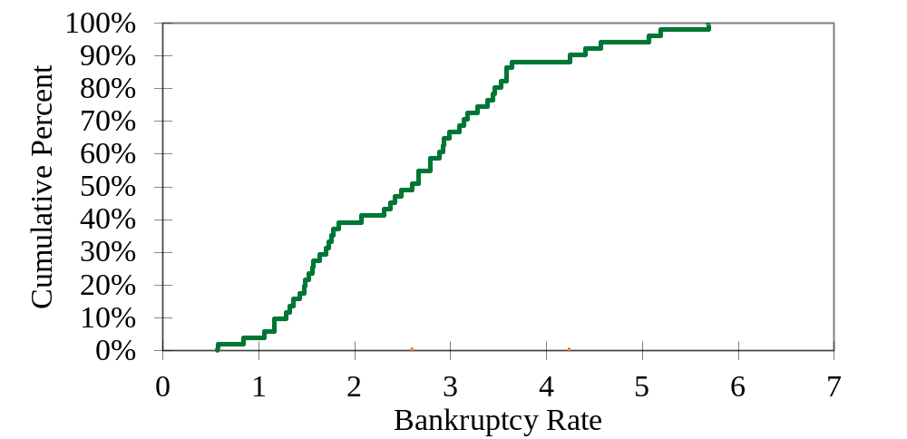
Example: Business Bankruptcies
Fig 4.2.9
Per thousand people, by state
  90th percentile is 4.24
  50th percentile is 2.60
Elsevier/Academic Press
© Andrew F. Siegel, 2016

Slide 31
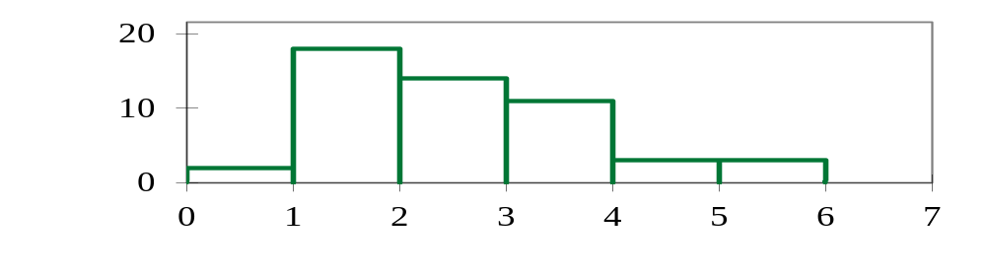
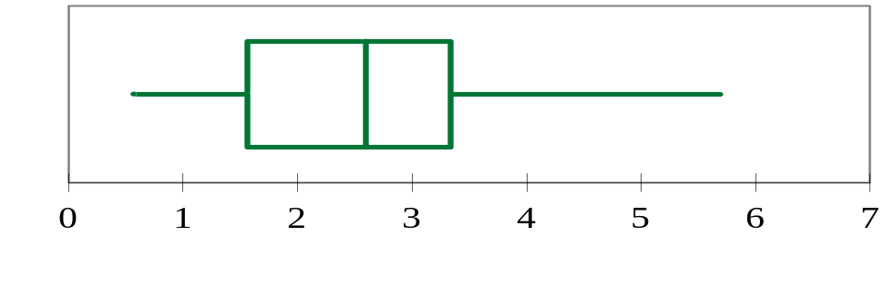
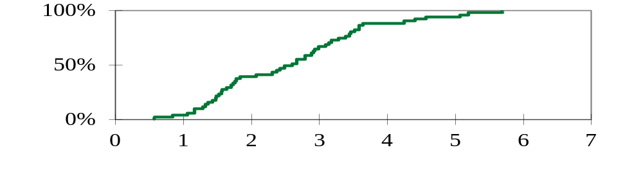
Example: Business Failures
Fig 4.2.10
Compare histogram, box plot, and CDF
Histogram
Bankruptcy rate
Box plot
Bankruptcy rate
CDF
Bankruptcy rate
Elsevier/Academic Press
© Andrew F. Siegel, 2016

